Slide 1

P925- Zomato Analytics
MODULE - MYSQL
GROUP - 6

Slide 2
Group-6 Members
Gunjan Mahato -mahatogunjan605@gmail.com
SHESHANK R -sheshankr001@gmail.com
Swapnil Ankush Dhok -swapnildhok835@gmail.com
KOTHAPALLI TRIVENI -triveniragothaman@gmail.com
Piyush Sunil Waskar -waskarpiyush15@gmail.com
Maloth.shobha -mlthshobha@gmail.com
Mohit kumar -mohitkumar628496@gmail.com

Slide 3
Objectives:
To analyze and visualize restaurant performance data from Zomato using a structured data model.
We built a calendar table to support time-based analysis across financial and calendar periods.
The data was transformed to standardize cost metrics in USD for global comparison.
Key insights were drawn from location-based restaurant counts, ratings, and cost segments.
Advanced KPIs such as booking availability and online delivery trends were evaluated.
An interactive dashboard was developed to present these insights in a business-friendly format.

Slide 4
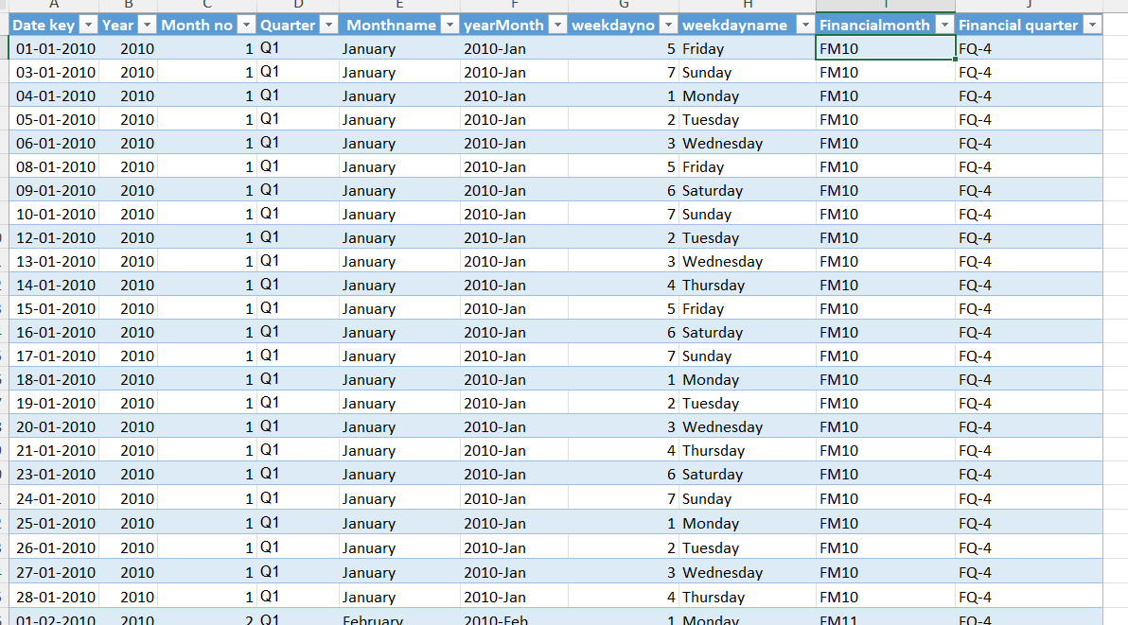
Q-1 Build a Calendar Table using the Columns Datekey_Opening ( Which has Dates from Minimum Dates and Maximum Dates)
Formulas:
="Q" & INT((MONTH(A2)-1)/3)+1
="FM" & IF(MONTH(A2)>=4, MONTH(A2)-3, MONTH(A2)+9)
="FQ-" & INT((IF(MONTH(A2)>=4, MONTH(A2)-3, MONTH(A2)+9)-1)/3)+1

Slide 5
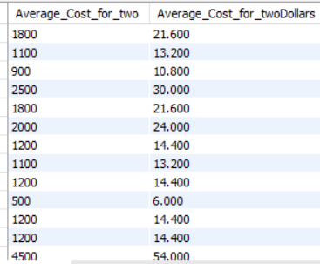
Q-2 Convert the Average cost for 2 column into USD dollars (currently the Average cost for 2 in local currencies)

Slide 6
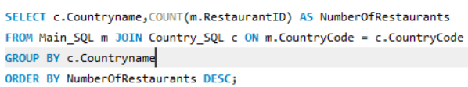

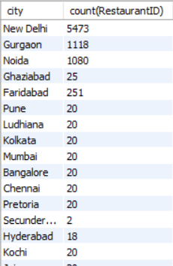
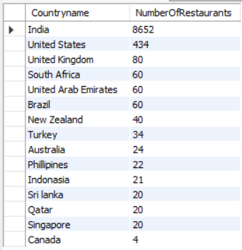
Q-3 Find the Numbers of Restaurants based on City and Country.

Slide 7
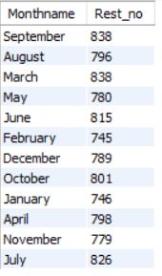
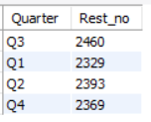
Q-4 Numbers of Restaurants opening based on Month , Quarter

Slide 8
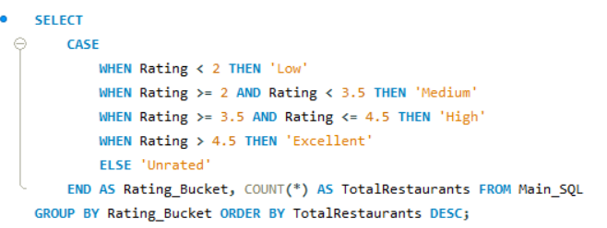
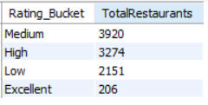
Q-5 Count of Restaurants based on Ratings Bucket

Slide 9
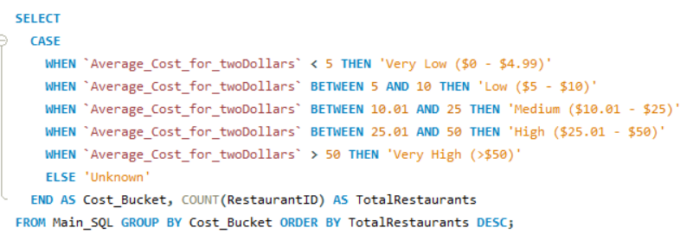
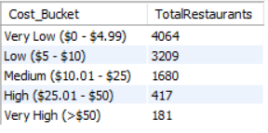
Q-6 Create buckets based on Average Price of reasonable size and find out how many restaurants falls in each buckets

Slide 10
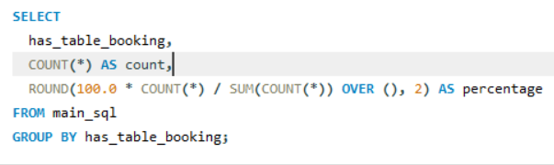

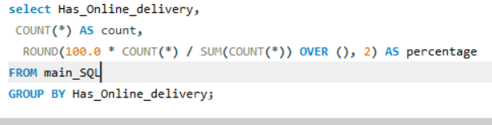

Q-7 Percentage of Resturants based on "Has_Table_booking“ Percentage of Resturants based on "Has_Online_delivery"

Slide 11
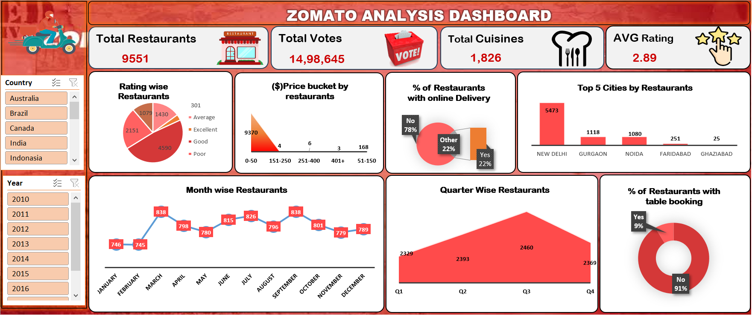
Excel Dash board

Slide 12
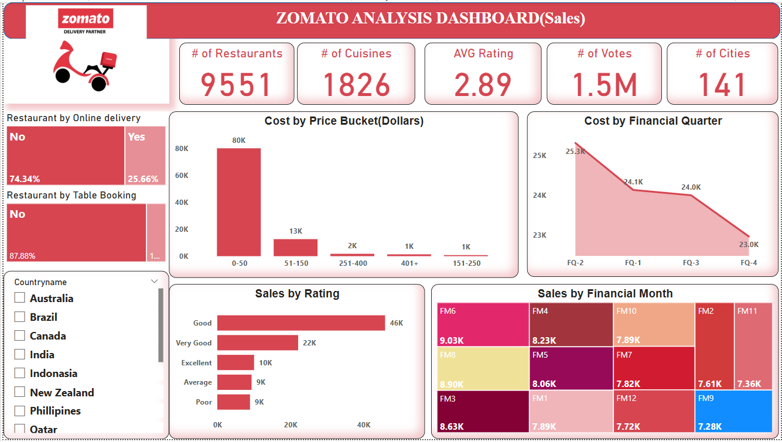
PowerBI Dash board-1

Slide 13
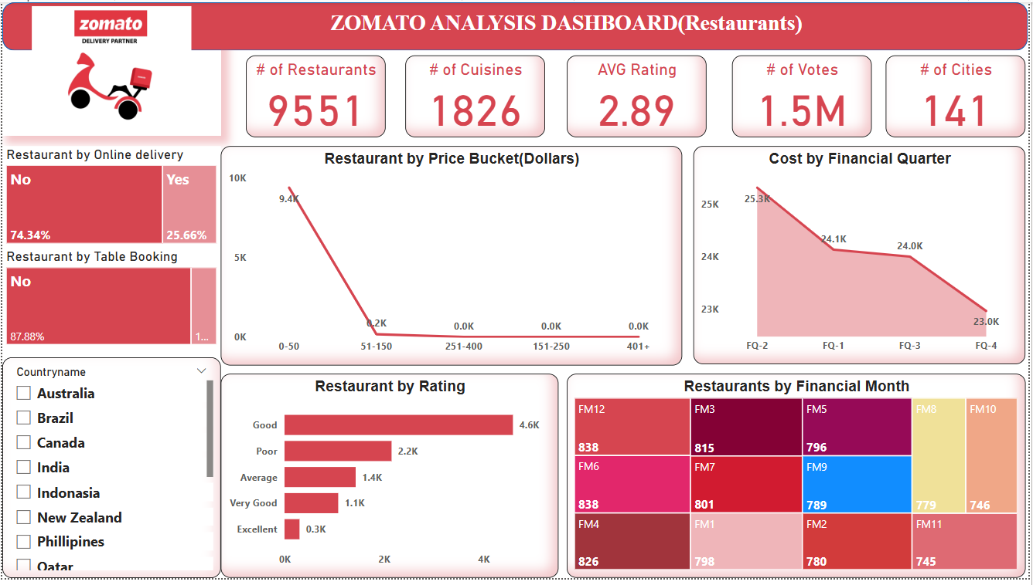
PowerBI Dash board-2

Slide 14
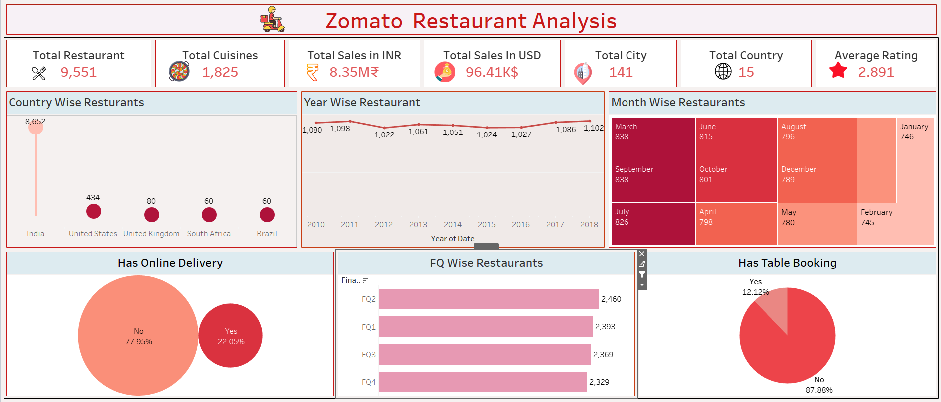
Tableau Dash board-1

Slide 15
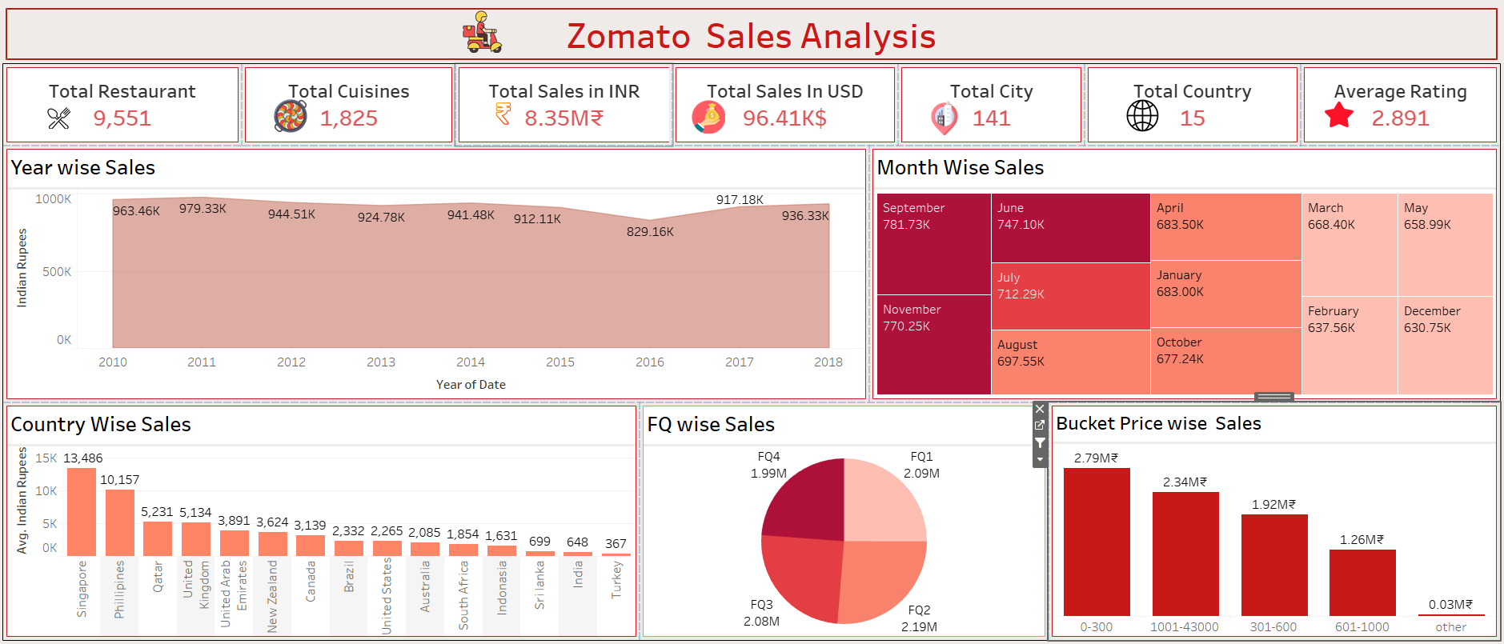
Tableau Dash board-2

Slide 16
Final Outcomes
India has the highest concentration of restaurants (8,652), indicating strong regional dominance.
Only 22% of restaurants offer online delivery, showing room for digital service expansion.
Most restaurants fall into Financial Quarters 1 & 2, suggesting seasonality in openings.
Average rating is relatively low at 2.89, signaling a potential quality perception issue.
Sales are highest in Singapore and the Philippines, despite low restaurant counts — indicating high spend per outlet.

Slide 17
Recommendations
Expand online delivery services across more regions to increase accessibility and sales.
Investigate and improve customer experience and quality to raise average ratings.
Focus marketing and expansion in high-revenue countries like Singapore, even with fewer restaurants.
Use month-wise and FQ-wise trends to time promotions or openings for maximum impact.
Explore underperforming cost buckets (₹601–₹1000) to optimize pricing strategy or service offerings

Slide 18
Challenges
Segregation of the Dates
Ensuring consistent data formatting across multiple sources (dates, currencies) required extensive cleaning.
Mapping financial periods and building time intelligence logic added complexity to the data model.

Slide 19

Thank You

